Slide 1
NINE-LEVEL INVERTER BASED ON SWITCHED-CAPACITANCE STRUCTURE
Guided By,
Prof. Sanish Kumar T G
Department of EEE
GEC Thrissur
Presented By,
Alin Anto(16) S8 EEE A
Abhilash M M(2) S8 EEE A
Don Dev(44) S8 EEE A
Devika Sajeev(40) S8 EEE A

Slide 2
Contents
Literature Survey
Topology
Simulation
Hardware Implementation
Result
Conclusion
References

Slide 3
Introduction
Recently, multilevel inverters (MIs) are getting more attention from researchers because of advantages like better waveform quality, lower EM noise, and lower device stress.
MIs are used to couple a DC source to an AC bus for applications like electric motor drivers, uninterruptible power supplies, and distributed generation systems.

Slide 4
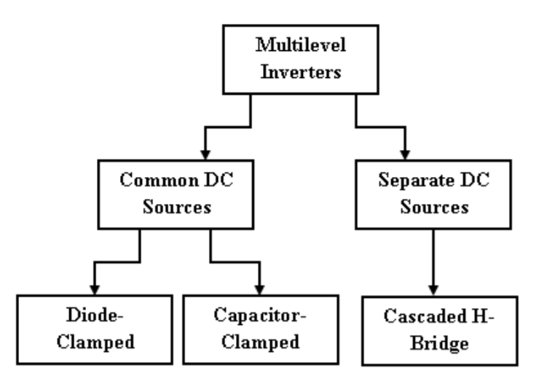
Literature Survey
The following topologies are now used in practice:-
Neutral-point clamped (Diode clamped)
Flying capacitor
Cascaded H-bridge (CHB)

Slide 5
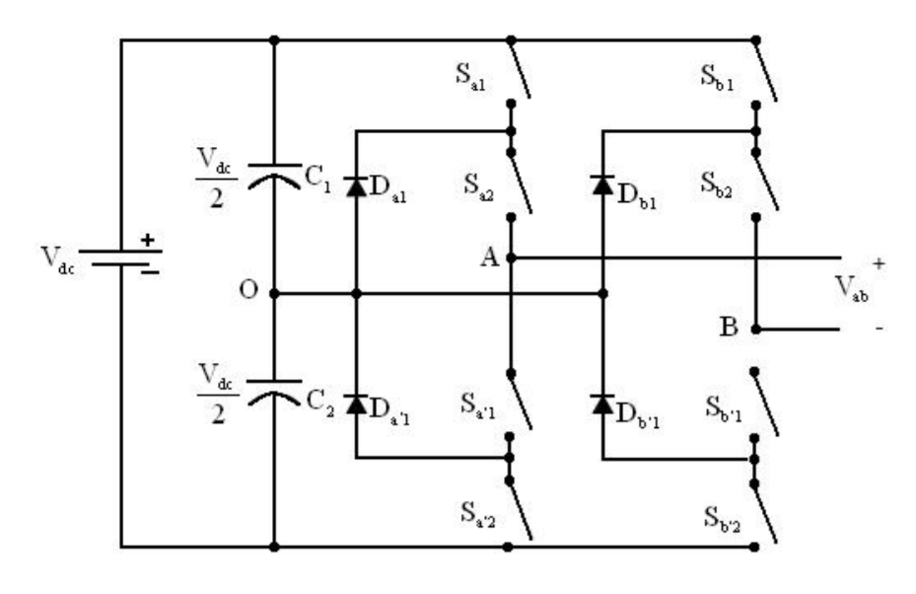
Neutral-point clamped (Diode clamped)
DISADVANTAGES
Using extra diodes in series becomes impractical when the number of levels n increases
The switch duty cycle is different for some of the switches requiring different current ratings
Capacitors do not share the same discharge or charge current resulting in a voltage imbalance of the series capacitors.

Slide 6
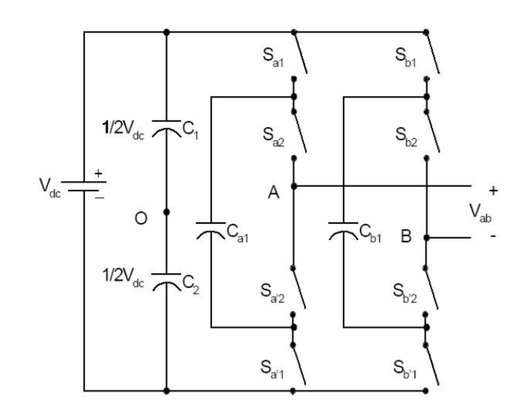
Flying Capacitor MI
DISADVANTAGES
Large numbers of capacitors are bulky and more expensive than the clamping diodes
Complex control is required to maintain the capacitor’s voltage balance.
Switching utilization and Efficiency are poor for real power transmission.

Slide 7
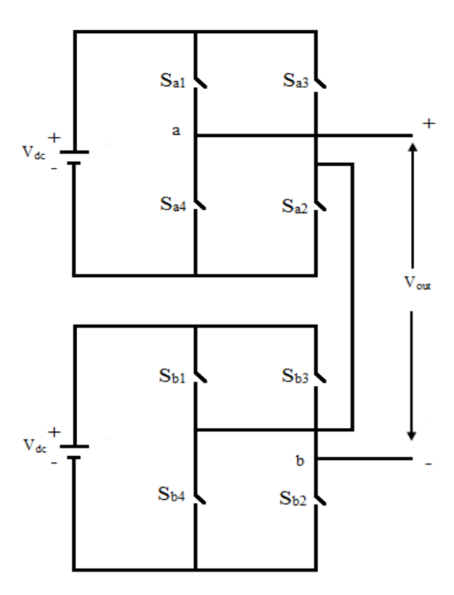
Cascaded H-Bridge MI
DISADVANTAGE
Needs separate DC sources.

Slide 8
Components count for a nine level inverter
DIODE CLAMPED
NO. OF DIODES: 28
FLYING CAPACITOR
NO. OF SWTICHES: 32
CASCADED H BRIDGE
NO. OF CAPACITOR: 8
NO. OF CAPACITOR: 64
NO. OF POWER SOURCES: 4
NO. OF SWTICHES: 32
NO. OF SWTICHES: 16

Slide 9
Summary of existing topologies
Large number of components( switches, power supplies, capacitors, and diodes)
Large size and high cost
Complex control.
For low-power applications, the system size and cost are the main concerns

Slide 10
System Objective
The objective of the system is to achieve the following characteristics for a SC-MI:
Fewer components(switches, sources & capacitors)
Smaller & less expensive.
Less complex control.
Requires only one power DC source.
Boost operation without magnetic elements.

Slide 11
Topology
Switched-capacitor (SC) structure is added to the H-bridge inverter.
The SC structures use capacitors, switches, and diodes to create a multilevel DC voltage at the DC bus of the H-bridge circuit.
H-bridge circuit inverts the multilevel DC voltage to AC voltage.
DSPIC
UNREGULATED DC
SWITCHED CAPACITOR STRUCTURE
MULTILEVEL DC
H-BRIDGE
REGULATED AC

Slide 12
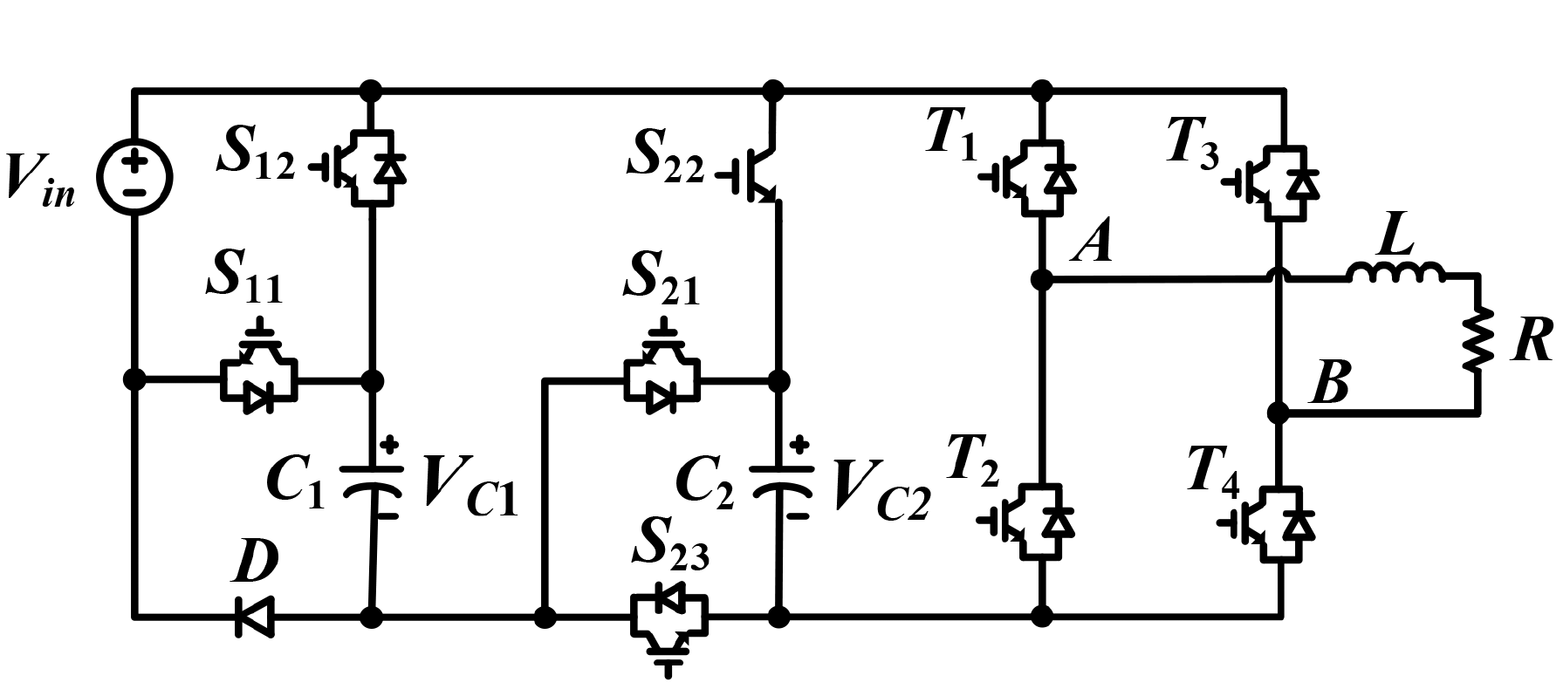
Schematic
SC nine-level inverter topology
The first SC cell :(C₁-D-S₁₁-S₁₂),
The second SC cell :(C₂-S₂₁-S₂₂-S₂₃).

Slide 13
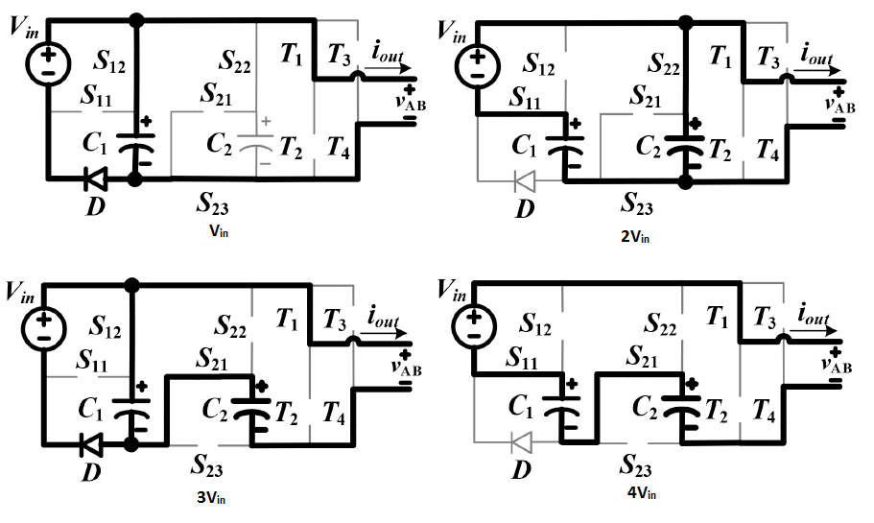
Modes of operation
1V_{in} – Source and C₁ in parallel.
2V_{in} – Source and C₁ in series which is then parallel with C_{2.}
3V_{in} – Source and C₁ in parallel which is then series with C_{2.}
4V_{in} – Source, C₁ and C₂ all in series.

Slide 14
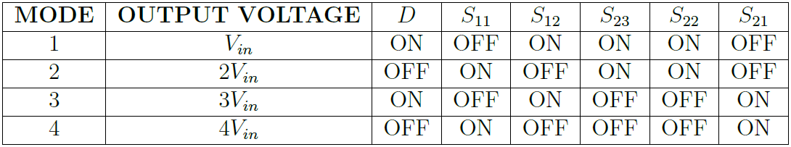
Switching States

Slide 15
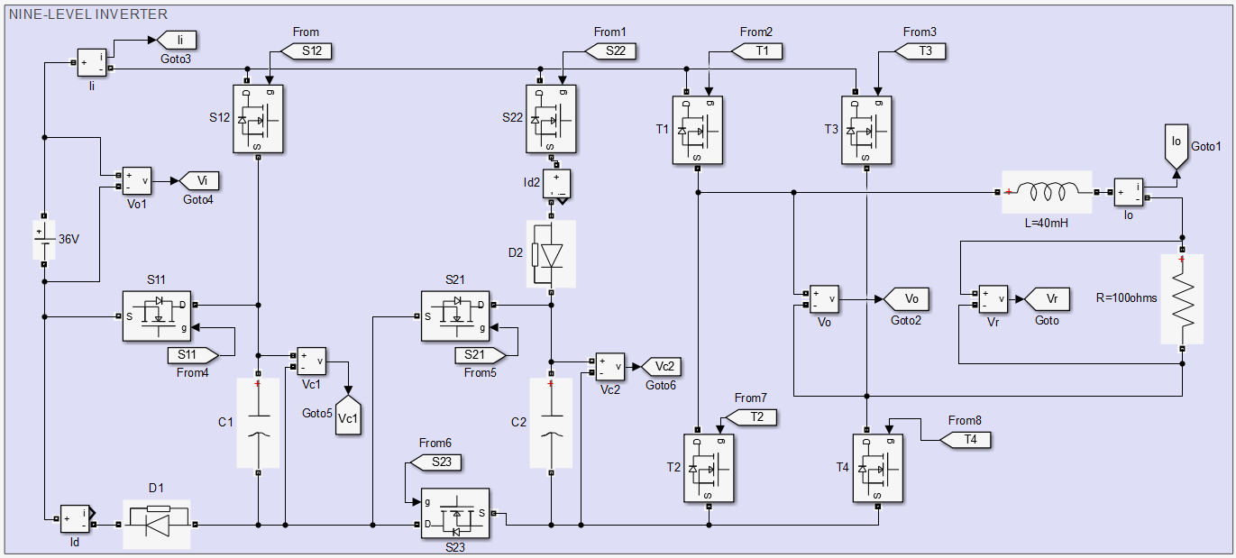
Simulation
9 Level inverter using 9 Switches 2 diodes.
Simulink model

Slide 16
Model Parameters
Input Voltage: 36V
Output Voltage : 100V(RMS)
Output Power: 100Watts
RL load: 100+ j12.5 ohms
Switching frequency: 5KHz
C₁ : 2400µF
C₂ : 3600uF

Slide 17
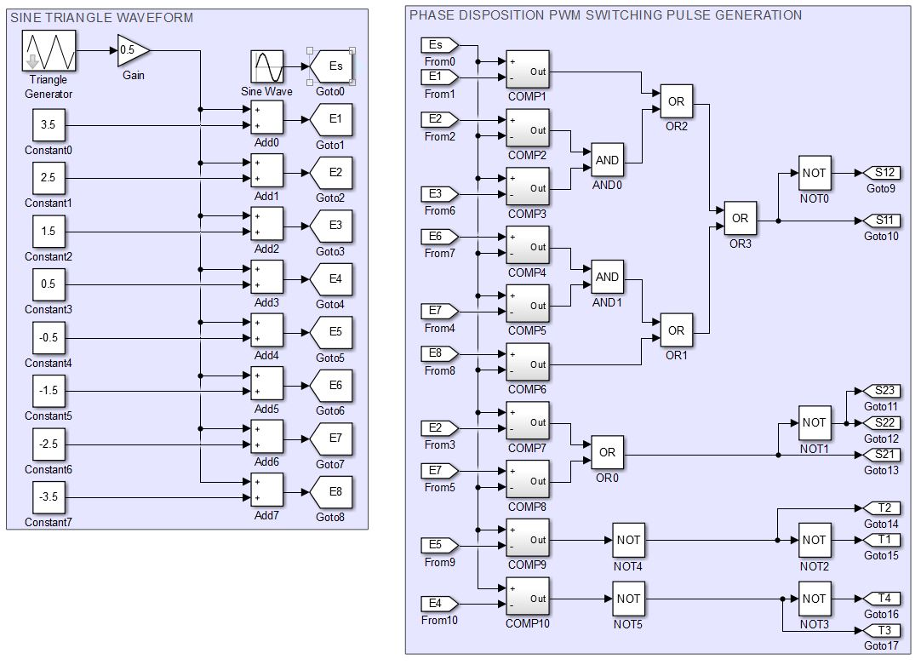
Switching Scheme:PDPWM

Slide 18
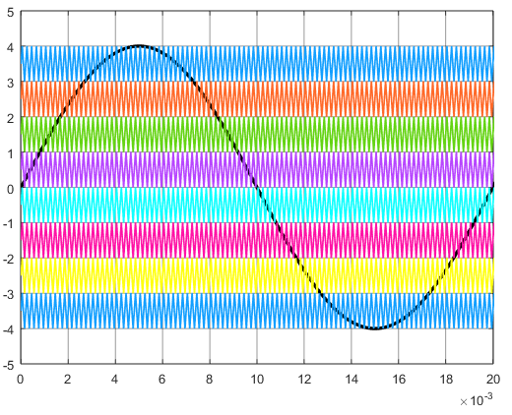
Switching Scheme:PDPWM

Slide 19
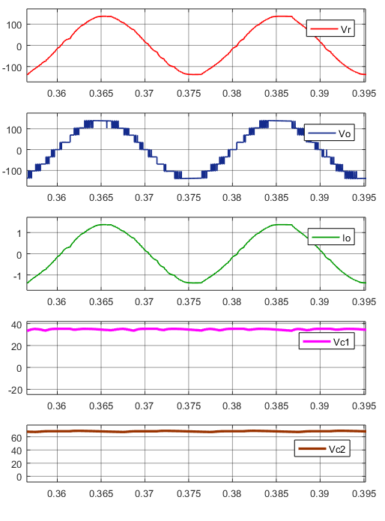
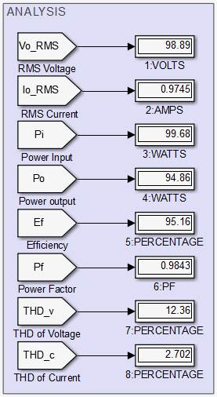
Simulation Result

Slide 20
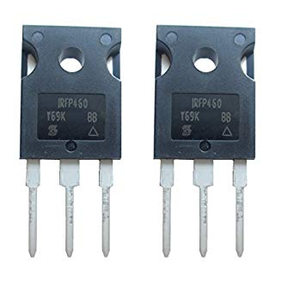
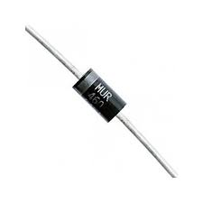
Hardware Implementation
Switching Device: MOSFET IRFP460
Drain to source breakdown Voltage (V_{DS}) : 500V
Continuous Drain Current(I_{D}) : 20A
Turn On delay time(T_{ON}) : 18nS
Turn Off delay time(T_{OFF}) : 110nS
Gate Source Threshold(V_{GST}) : 4V
Diode : MUR460
DC blocking Voltage (V_{R}) : 600V
Continuous Forward Current(I_{F}) : 4A
Reverse Recovery time(T_{rr}) : 75nS
Forward Recovery time(T_{fr}) : 50nS
C₁ :2400µF
C₂ :3600µF

Slide 21
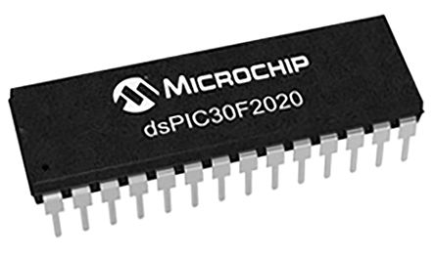
Hardware Implementation
Logic Controller : DSpic30F2020
Three 16-bit timers/counters
Up to 30 MIPS operation
Four PWM generators with 8 outputs
Individual dead time for each PWM generator
PWM modes supported:
- Complementary
- Push-Pull
- Multi-Phase
- Variable Phase
- Current Reset
- Current-Limit

Slide 22
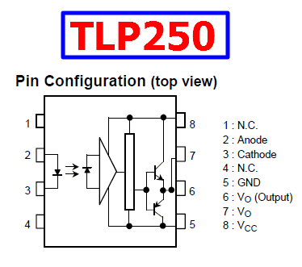
Gate Driver Opto Coupler
Provides Isolation
Converts 5v pulses from Dspic to 15v Gate pulse for Mosfet
Input threshold current: I_{F}=5mA(max)
Supply voltage (V_{CC}): 10−35V
Isolation voltage: 2500V_{rms}(min)

Slide 23
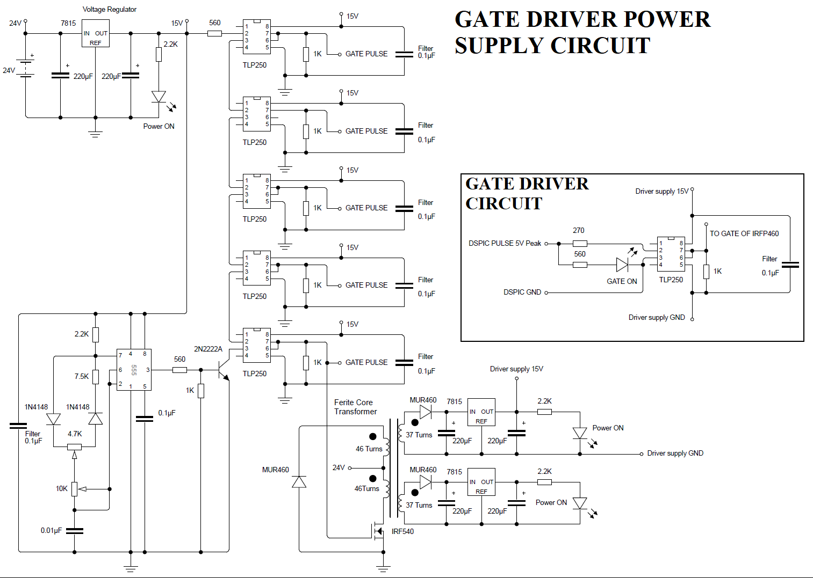

Slide 24
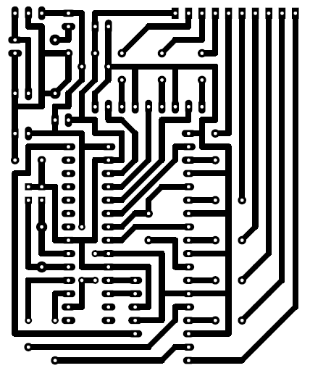
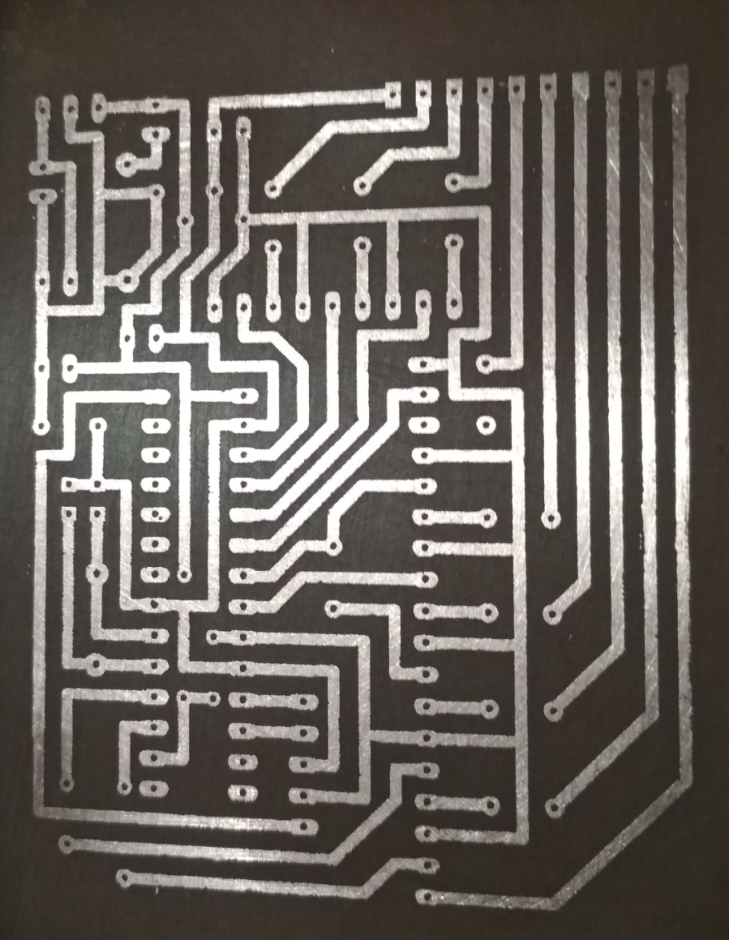
PCB Realization
Dspic Board Design
Dspic Board PCB Realization

Slide 25
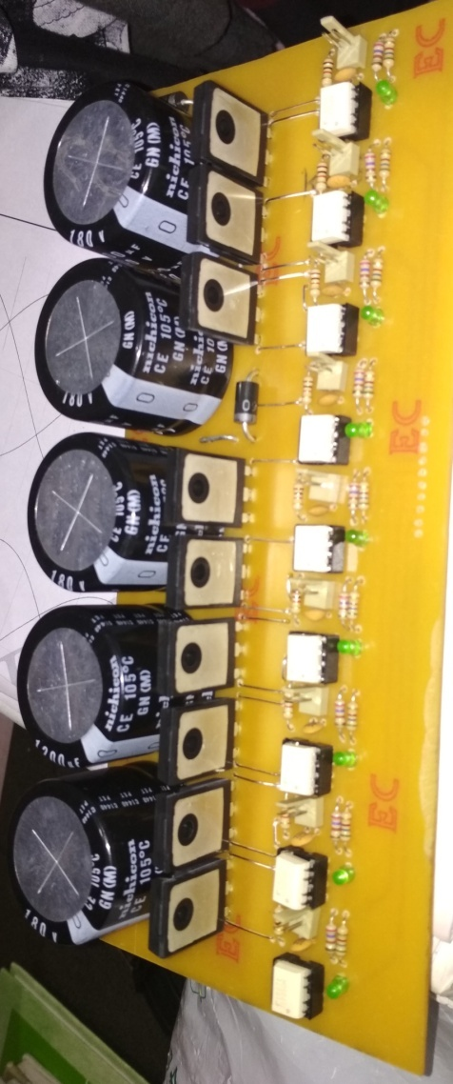
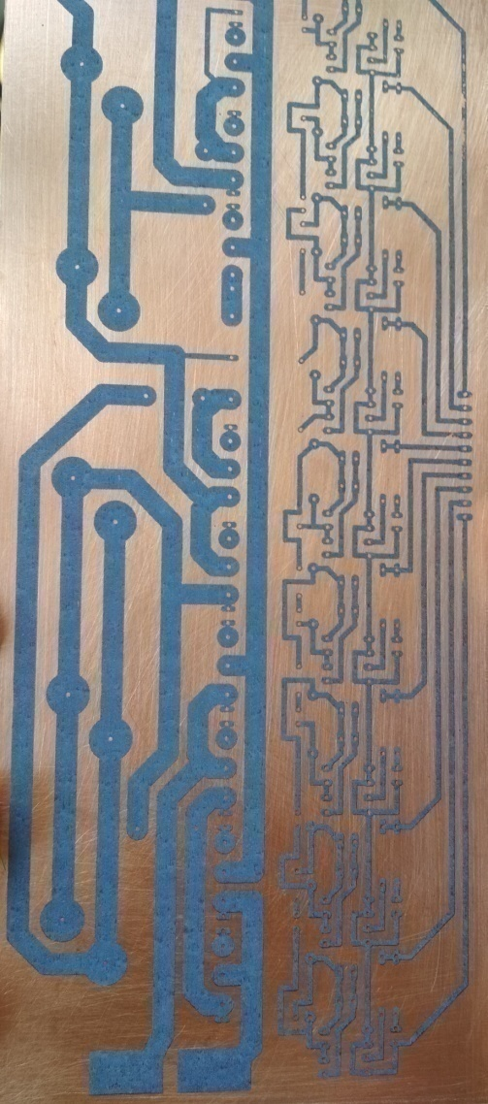
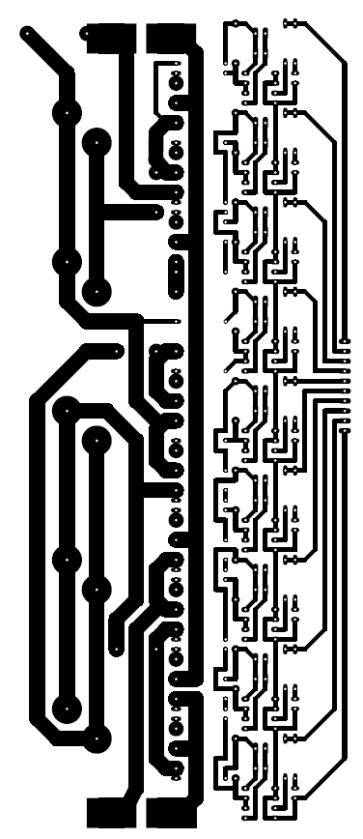
PCB Realization
INVERTER REALIZATION
PCB TONER TRANSFER
INVERTER PCB DESIGN

Slide 26
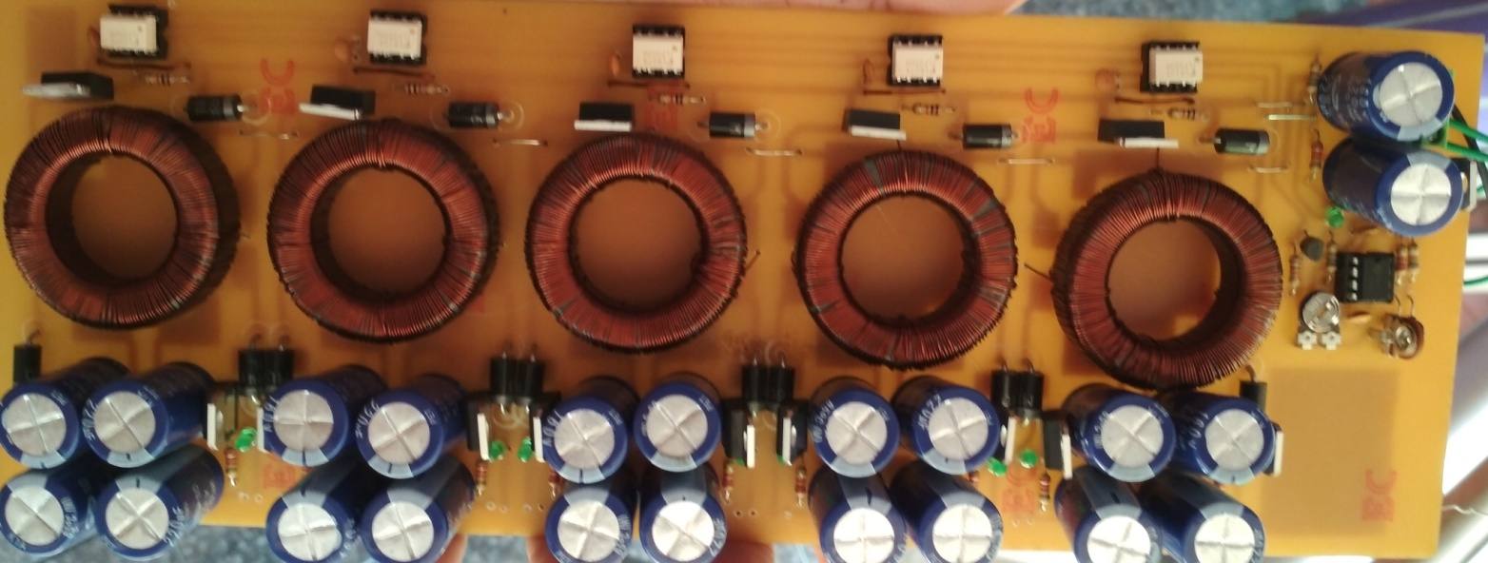
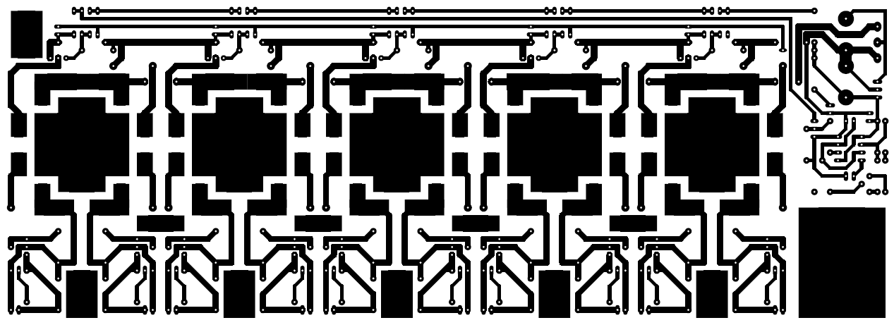
PCB Realization
DRIVER SUPPLY
REALIZATION
DRIVER SUPPLY
PCB DESIGN

Slide 27
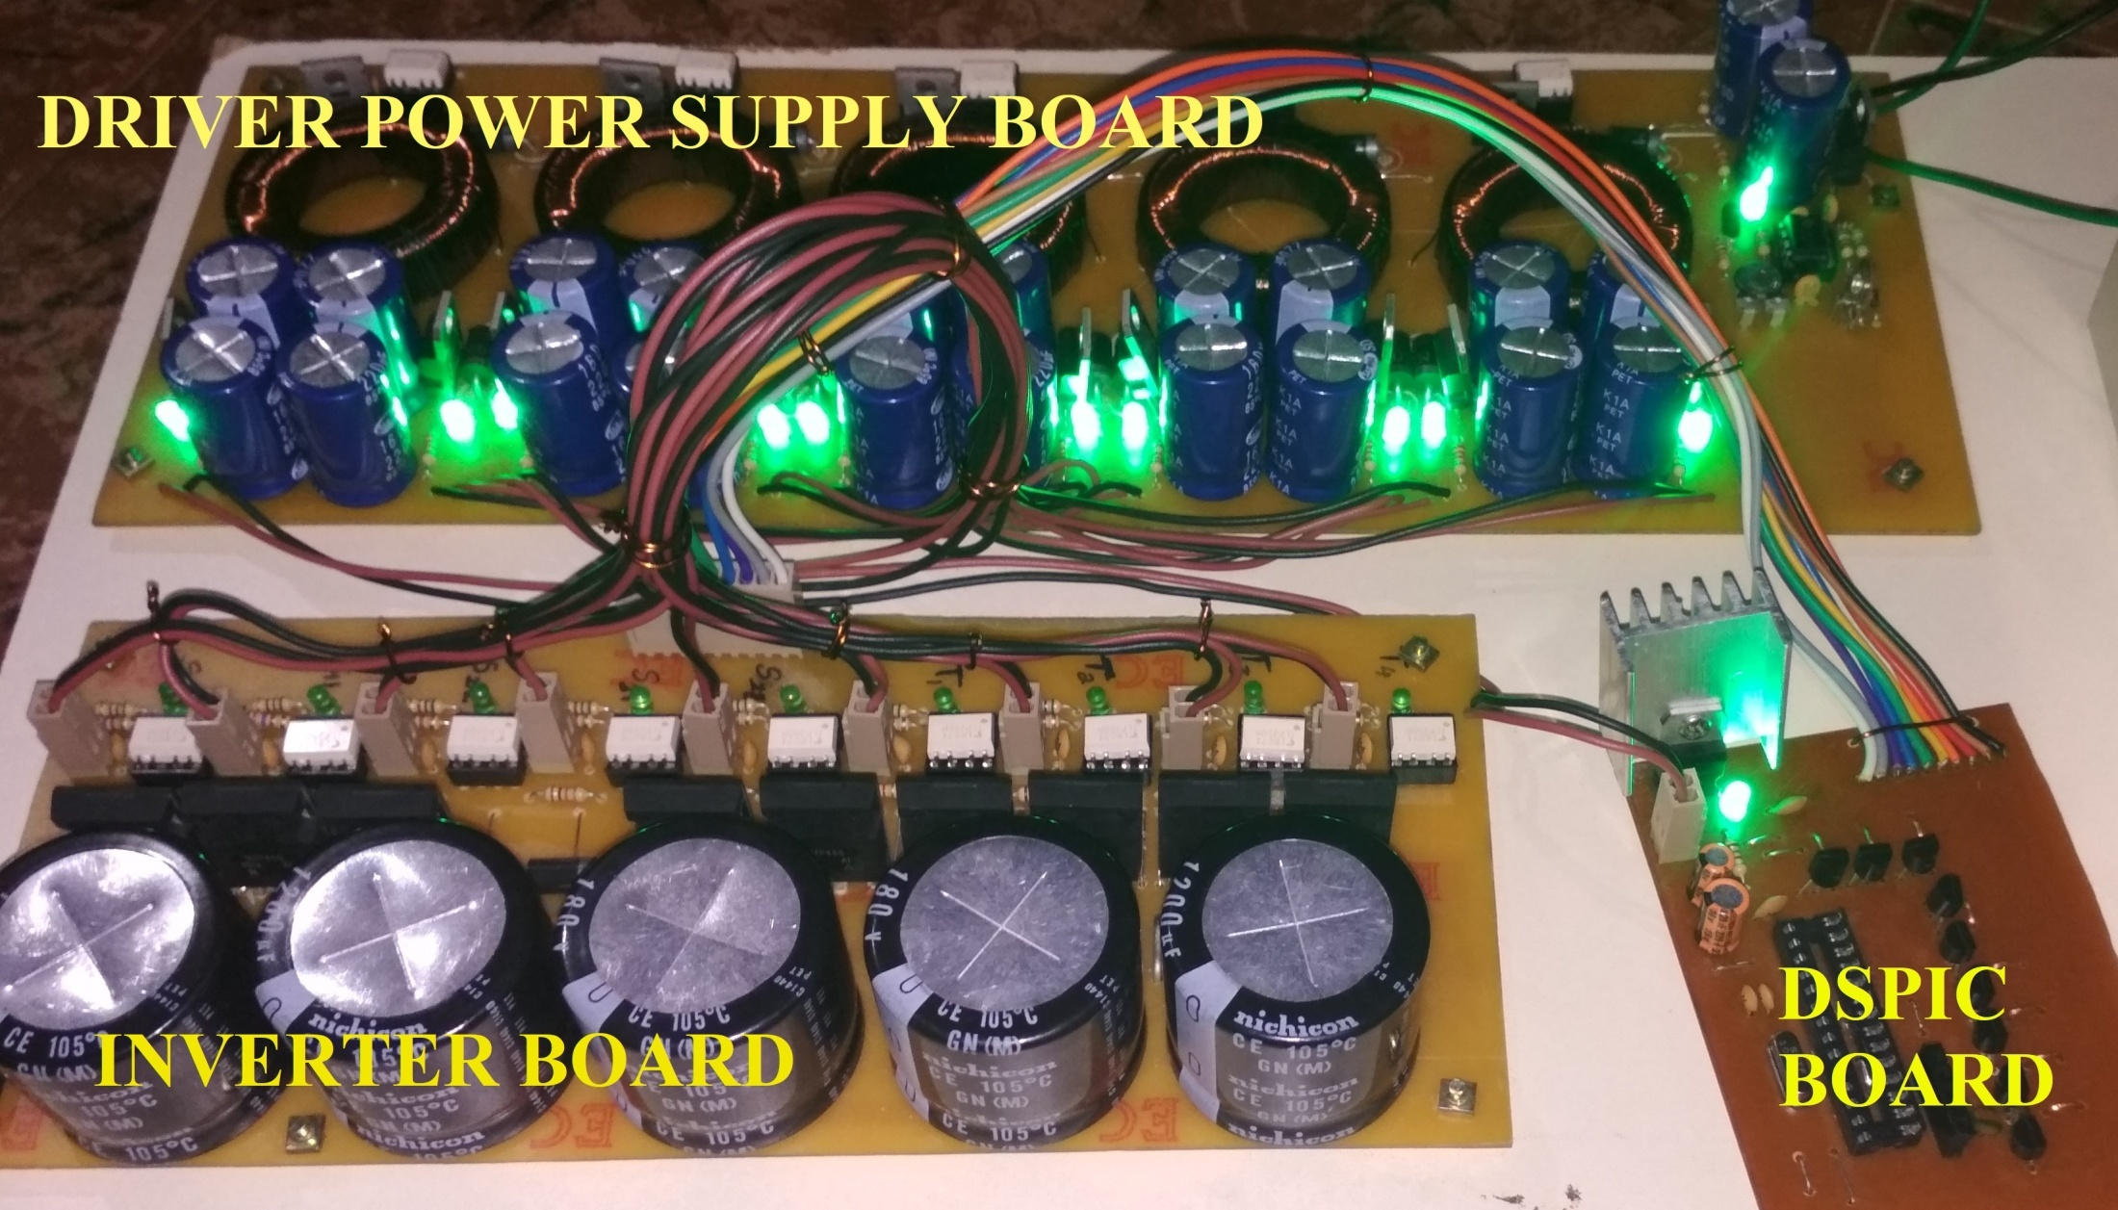
Hardware Realization

Slide 28
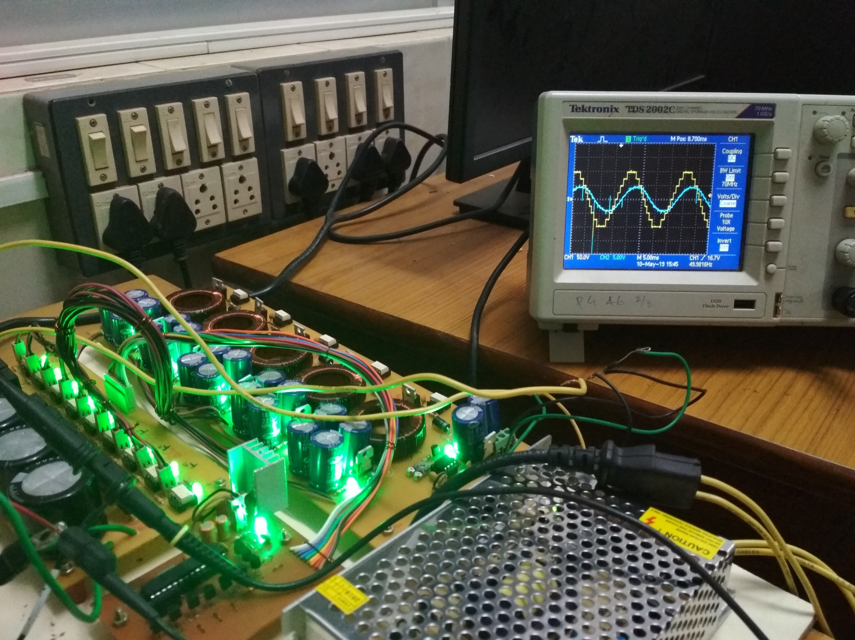
Hardware Realization

Slide 29
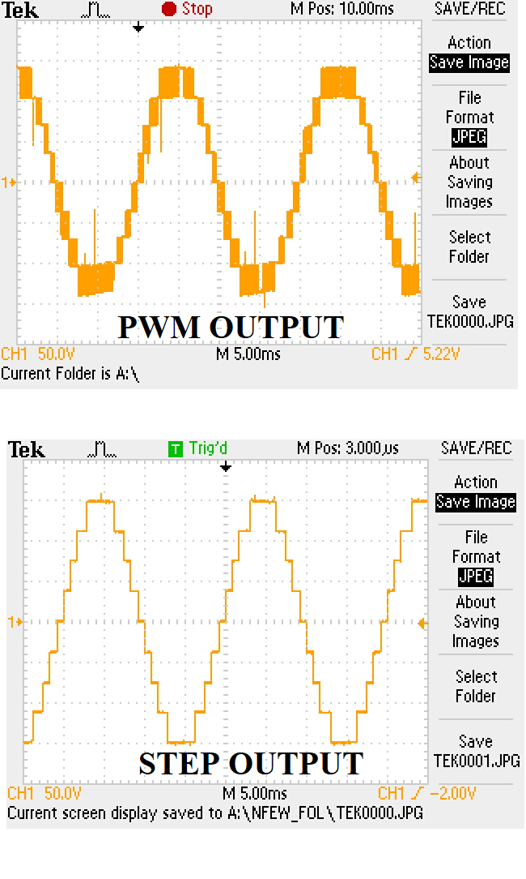
Results
Simulation Pk-Pk: 300Volts
Pk-Pk Voltage: 300 Volts

Slide 30
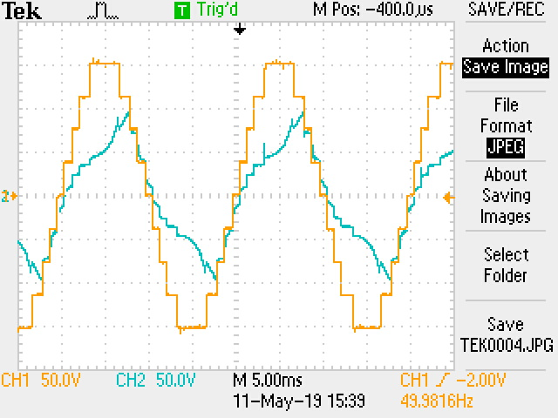
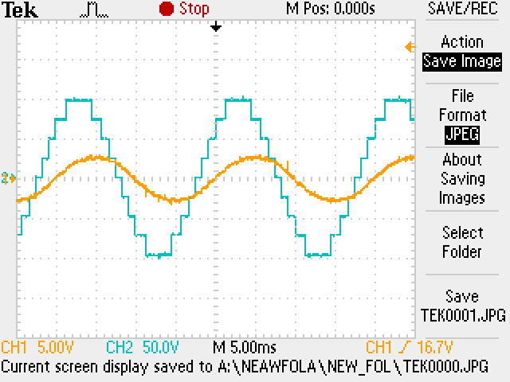
RL Load @ High Power Factor
High THD
The reactance acts as a filter to remove the high frequency components of current.
RL Load @ Low Power Factor
Low THD

Slide 31
Conclusion
Literature survey of the existing multilevel inverter topology was carried out.
Some shortcomings were discovered and a new topology based on switched capacitor structure was found to be a solution.
The simulation and modelling of the inverter based on switched capacitor was done.
Hardware implementation was done to verify the same and was found to be in agreement with the simulation findings.
Documentation of the findings and results were prepared.

Slide 32
REFERENCE
[1] Bac-Bien Ngo, Minh-Khai Nguyen , Jae-Hong Kim2 and Firuz Zare, “Single-phase multilevel inverter based on switched-capacitor structure”, IET Power Electron, June 2018, ISSN 1755-4535
[2] Barry W Williams, “Principles and Elements of Power Electronics Devices, Drivers, Applications, and Passive Components”, 2006, ISBN 978-0-9553384-0-3
[3] Yuanmao Ye, K. W. E. Cheng, Junfeng Liu and Kai Ding, “A Step-Up Switched-Capacitor Multilevel Inverter With Self-Voltage Balancing”, IEEE Trans. Ind. Electron, Vol. 61, No. 12, December 2014
[4] Bhagyalakshmi P S, Beena M Varghese and Dr. Bos Mathew Jos, “Switched Capacitor Multilevel Inverter With Different Modulation Techniques”, International Conference on Innovations in information Embedded and Communication Systems, 2017

Slide 33
Thank you

